Slide 1


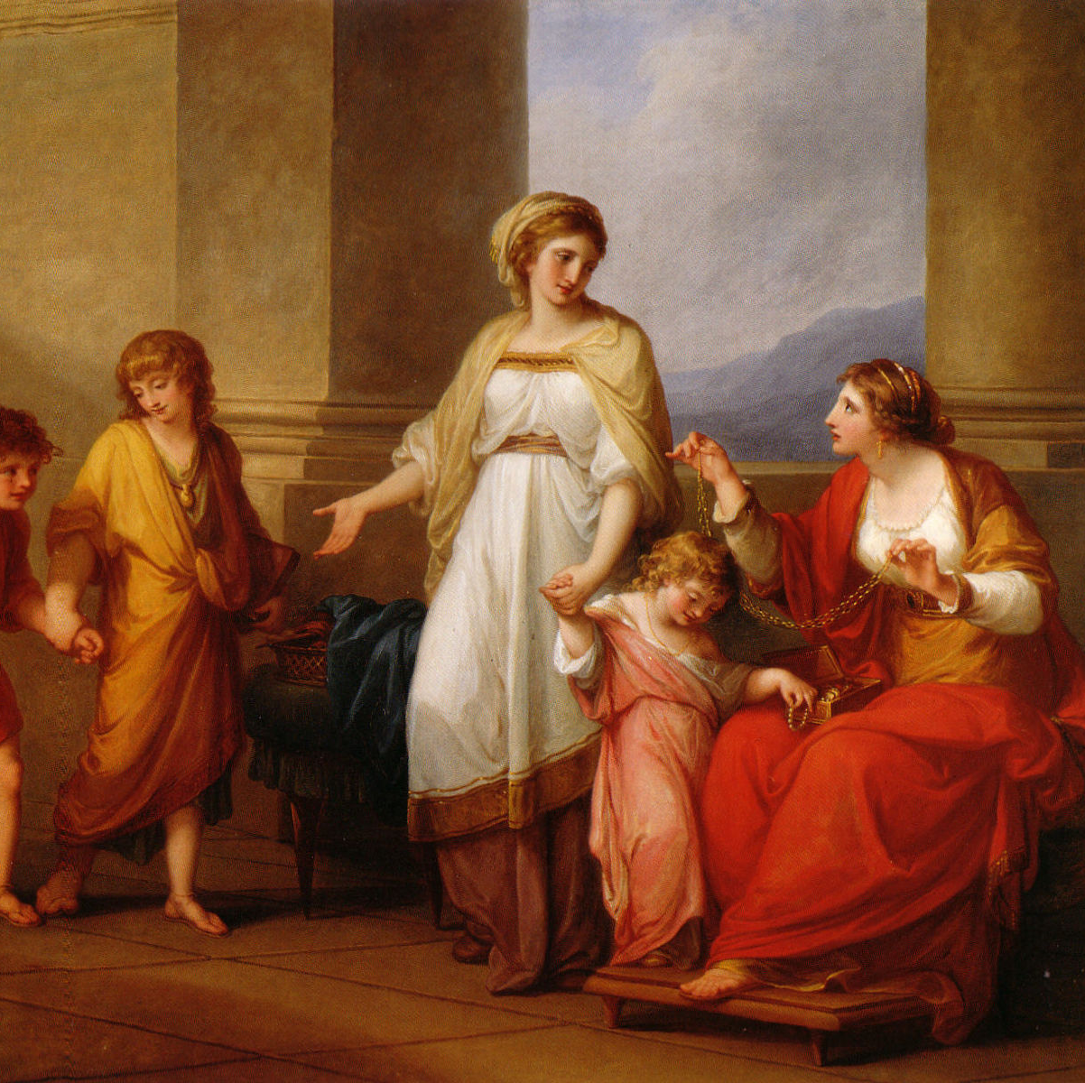
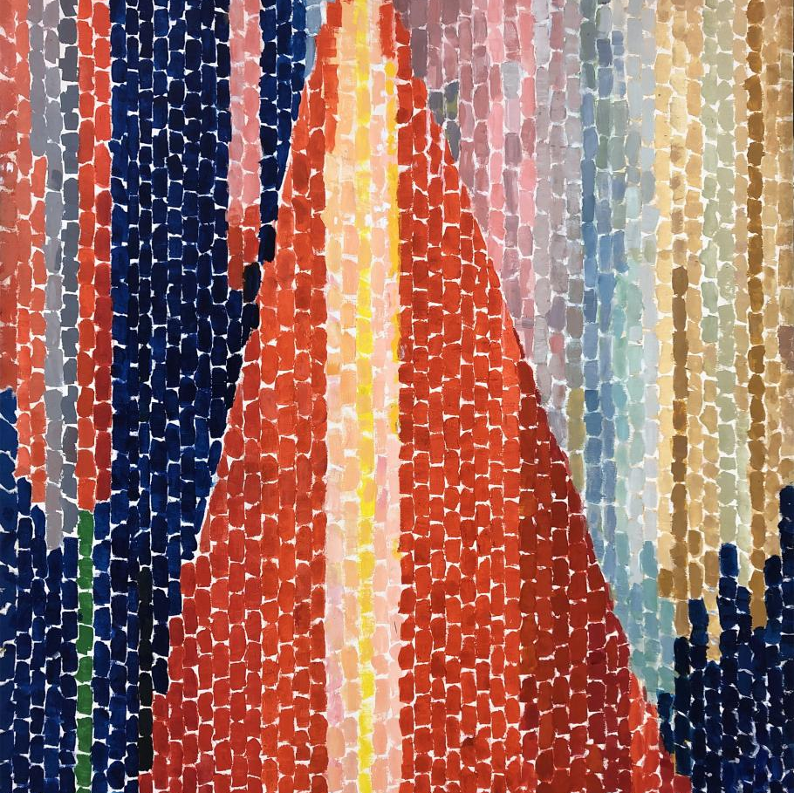
The Visual Chronicles: An Art Journey through Time & Place
By Sophia E. Learning
Art History II
March 15, 2025

Slide 2
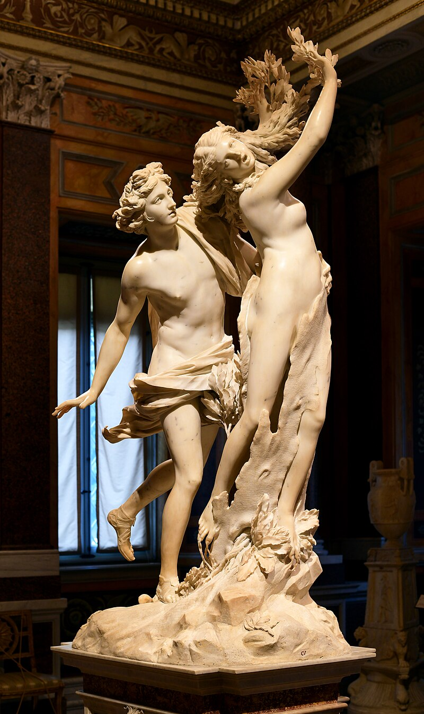
Artwork that presents the human body
Artist: Gian Lorenzo Bernini
Title: Apollo and Daphne
Date: 1622-1625
Medium: Marble
Note: this work does not come from the course but is offered as a guideline.
Notes:
Visual features: Bernini's Apollo and Daphne depicts a moment of metamorphosis, as Daphne's body transforms into a tree while she attempts to escape Apollo's grasp. The freestanding marble work invites the viewer to circle the sculpture and observe implied movement during the dramatic moment. From the soft texture of human skin to the rough tree trunk and nearly transparent laurel leaves, Bernini adeptly manipulates stone to depict contrasting tactile experiences.
Contextual background: As an iconic example of the Italian Baroque, Apollo and Daphne includes the drama and movement typically associated with this period (Sophia Learning, n.d.). Whereas sculptures from the previous Renaissance era tended to be balanced and restrained, Bernini's Baroque works are known for their intense theatricality and innovative storytelling. Though this early Bernini work was sourced from the ancient mythological text Ovid's Metamorphoses, Bernini would later use his expertise to gain papal commissions and depict Christian narratives.
Art Historical Significance: Bernini's sculptures, particularly Apollo and Daphne, offer a dual visual experience of extreme realism and fantasy. By showing a myth at its climax, Bernini appeals to human imagination while still capturing lifelike details with near anatomical perfection. Bernini's sheer mastery of marble is emblematic of the Baroque period in Italy and an exemplary representation of how the human body was represented during this time of innovation (Sophia Learning, n.d.).

